Slide 1
SafeHire
AI-Powered Service Hiring Platform
Smarter Hiring for Safer Services
Afridur Rahman Khan Mim | Md. Zarif Hossain Alvi | Nazia Faruque Diya

Slide 2
Problem Statement
• Difficult to find reliable workers • Workers often unverified • No intelligent worker recommendation • Safety and trust issues in hiring
Afridur Rahman Khan Mim | Md. Zarif Hossain Alvi | Nazia Faruque Diya

Slide 3
SafeHire Solution
SafeHire provides worker registration, profile verification, job posting, and AI-based worker recommendation to ensure safer hiring.
Afridur Rahman Khan Mim | Md. Zarif Hossain Alvi | Nazia Faruque Diya

Slide 4
Platform Workflow
Register Worker → Verify Profile → Post Job → Hire Safely
Register Worker
Verify Profile
Post Job
Hire Safely
Afridur Rahman Khan Mim | Md. Zarif Hossain Alvi | Nazia Faruque Diya

Slide 5
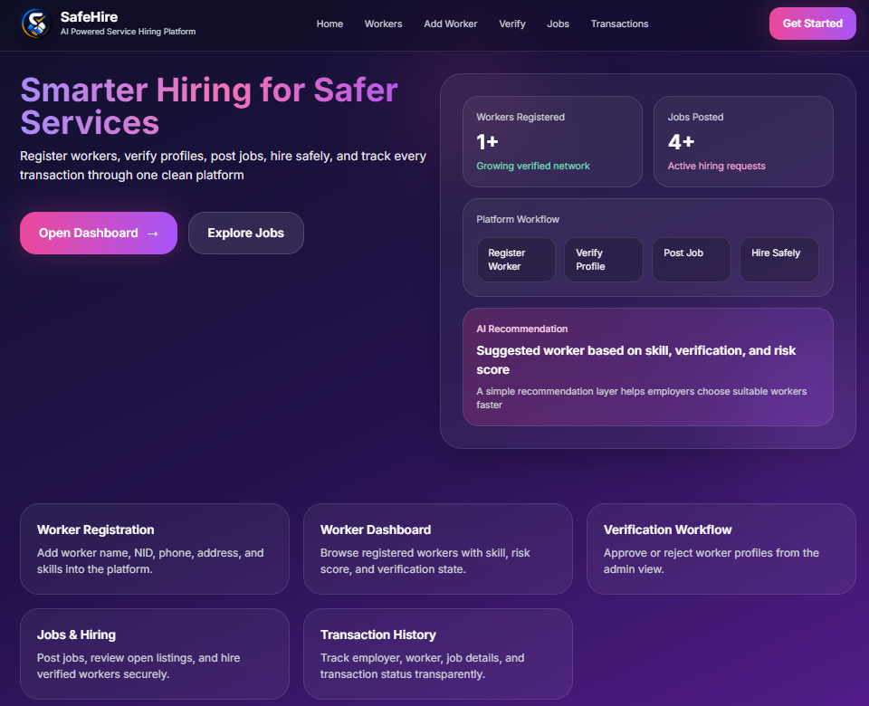
Home Page
• Shows platform overview • Displays worker and job statistics • Explains AI recommendation system
Afridur Rahman Khan Mim | Md. Zarif Hossain Alvi | Nazia Faruque Diya

Slide 6
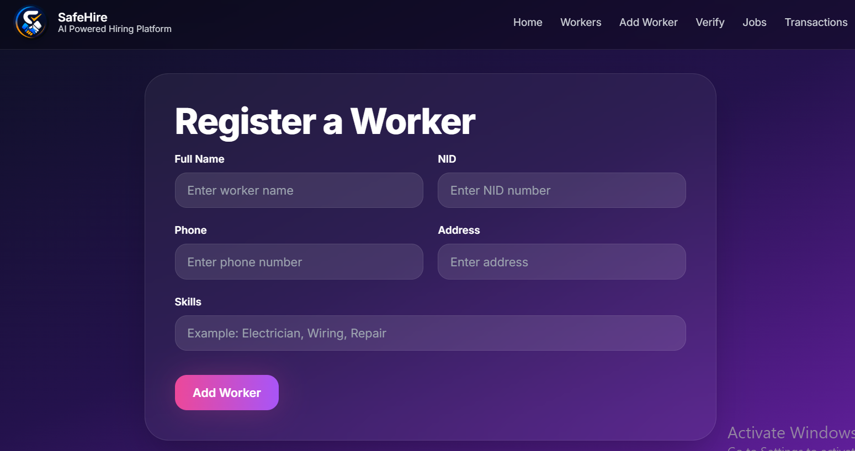
Worker Registration
• Admin registers workers • Information collected: Name, NID, Phone, Address, Skills • Creates worker profile in the system
Afridur Rahman Khan Mim | Md. Zarif Hossain Alvi | Nazia Faruque Diya

Slide 7
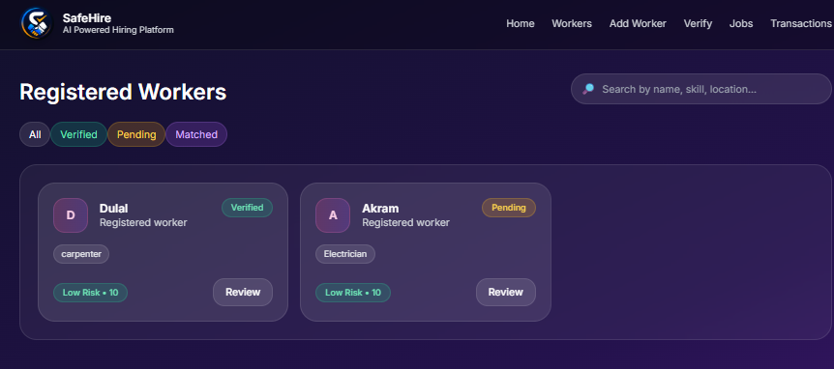
Workers Dashboard
• Displays registered workers • Shows skills and verification status • Risk score helps employers evaluate workers
Afridur Rahman Khan Mim | Md. Zarif Hossain Alvi | Nazia Faruque Diya

Slide 8
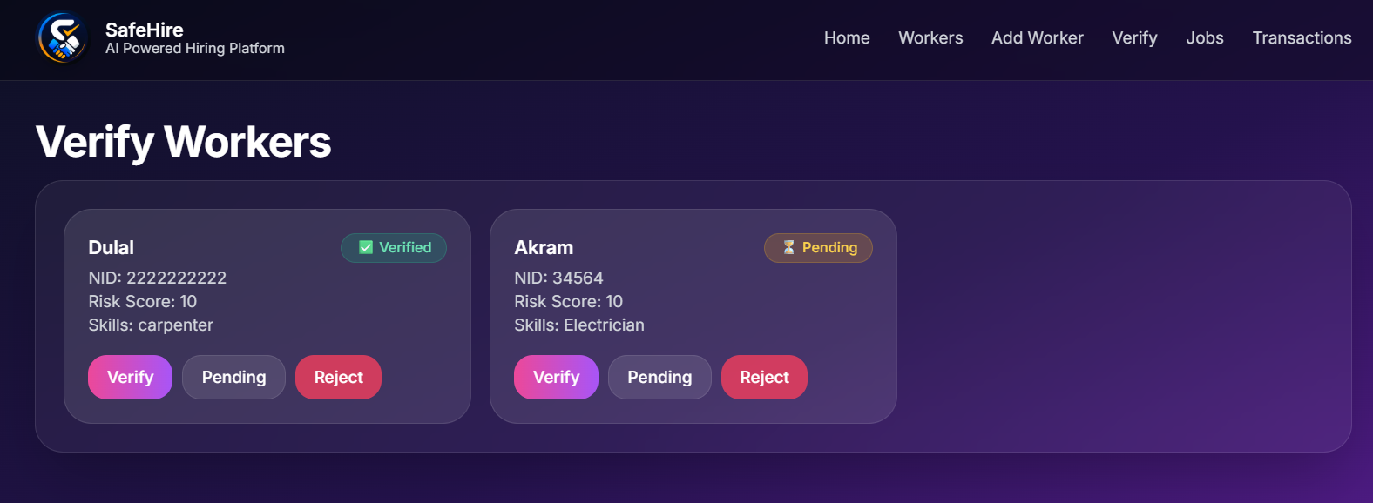
Worker Verification
• Admin reviews worker profiles • Options: Verify, Pending, Reject • Ensures trusted workers on the platform
Afridur Rahman Khan Mim | Md. Zarif Hossain Alvi | Nazia Faruque Diya

Slide 9
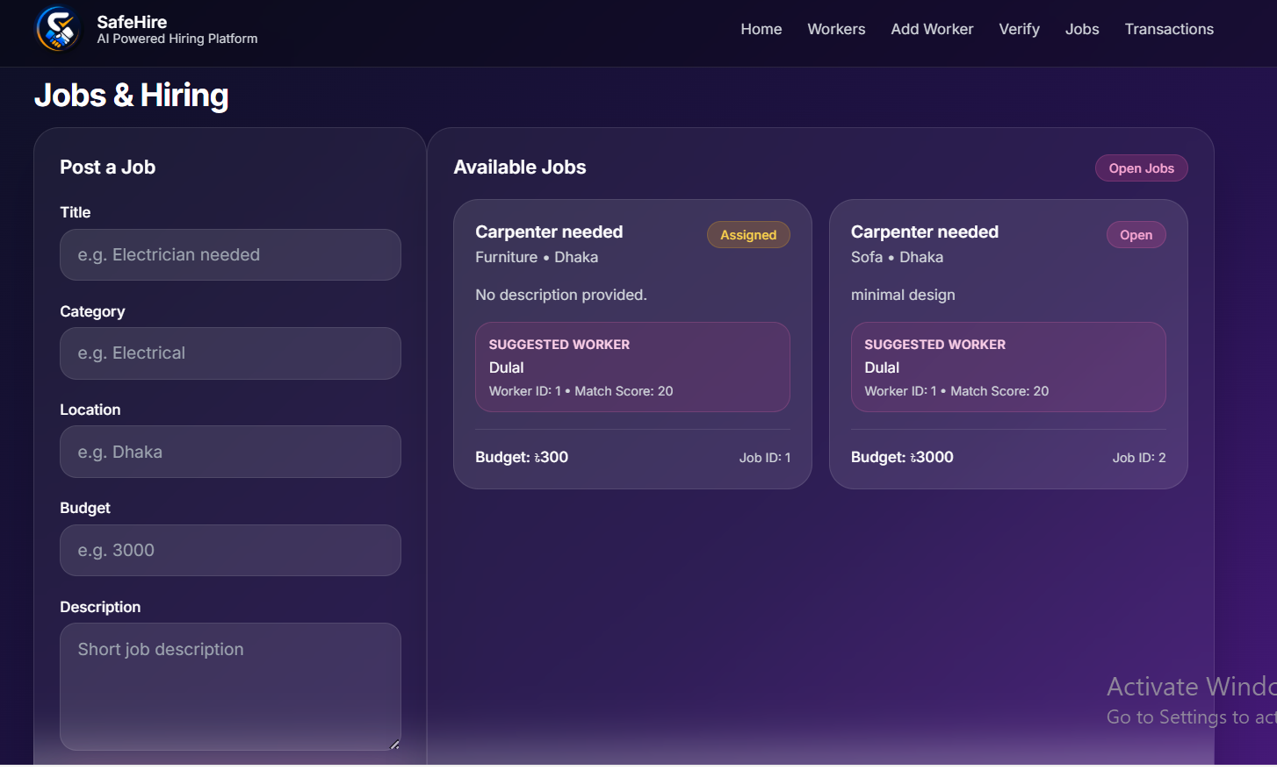
Jobs & Hiring
• Employers post jobs • Include category, location, budget • System suggests best worker automatically
Afridur Rahman Khan Mim | Md. Zarif Hossain Alvi | Nazia Faruque Diya

Slide 10
FUTURE IMPROVEMENTS
• Advanced AI matching algorithm • Rating and review system for workers • Secure identity verification
Afridur Rahman Khan Mim | Md. Zarif Hossain Alvi | Nazia Faruque Diya

Slide 11
Conclusion
SafeHire improves trust and efficiency in service hiring.
THANK YOU!!!!
Afridur Rahman Khan Mim | Md. Zarif Hossain Alvi | Nazia Faruque Diya

